Slide 1

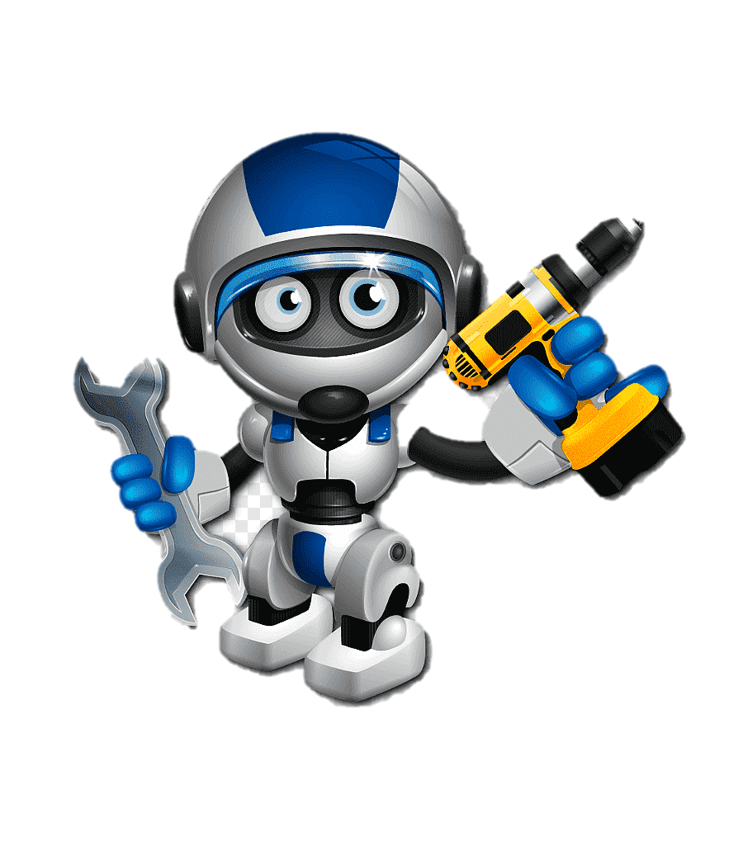
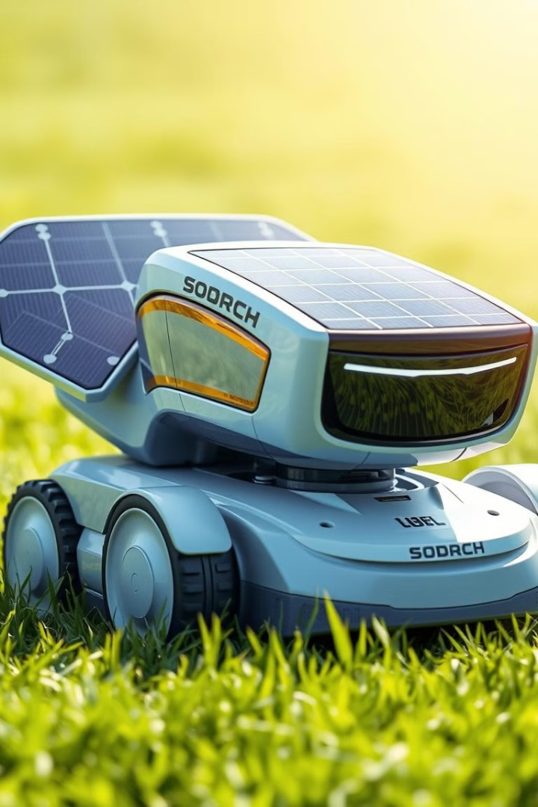
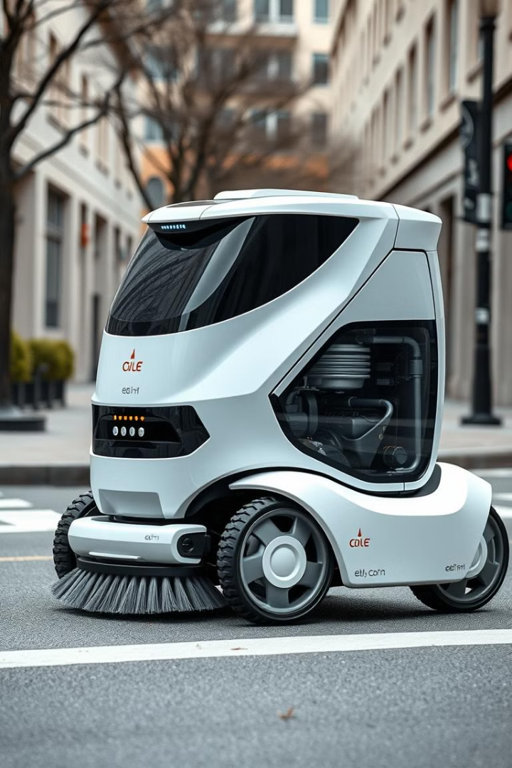
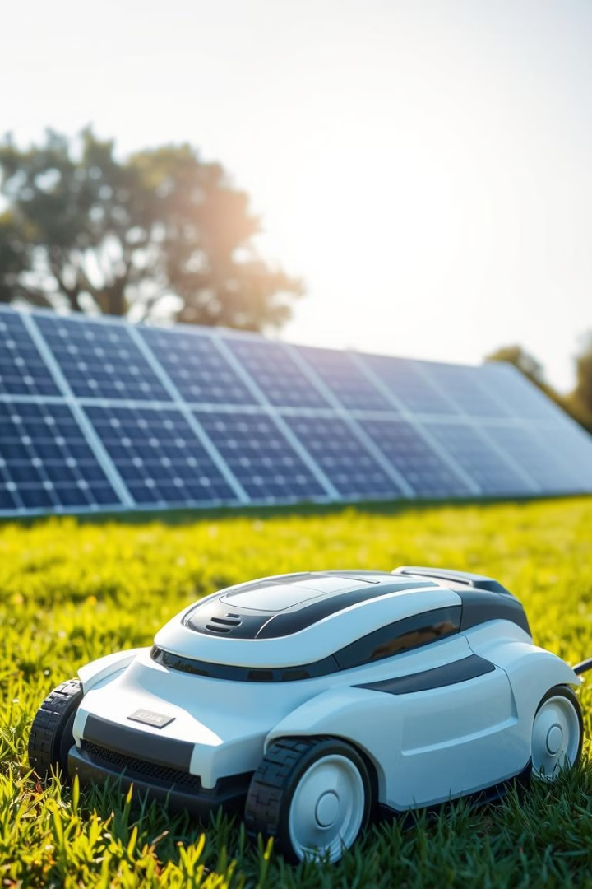
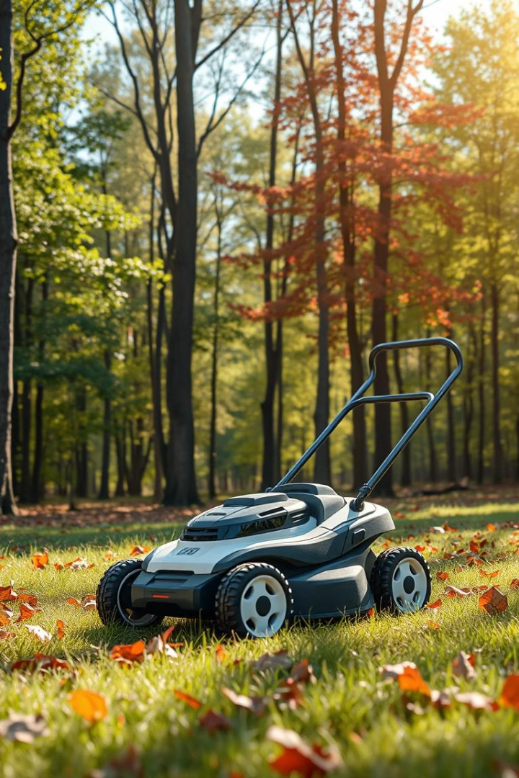
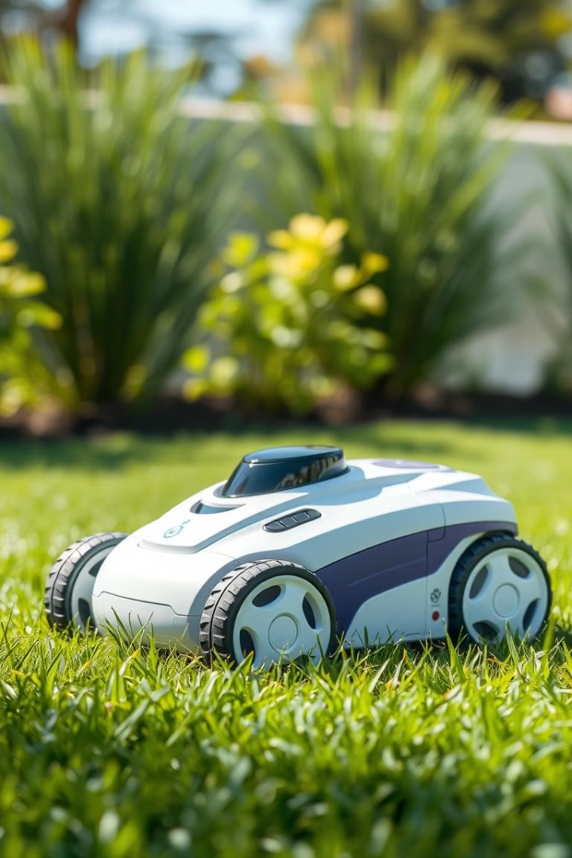
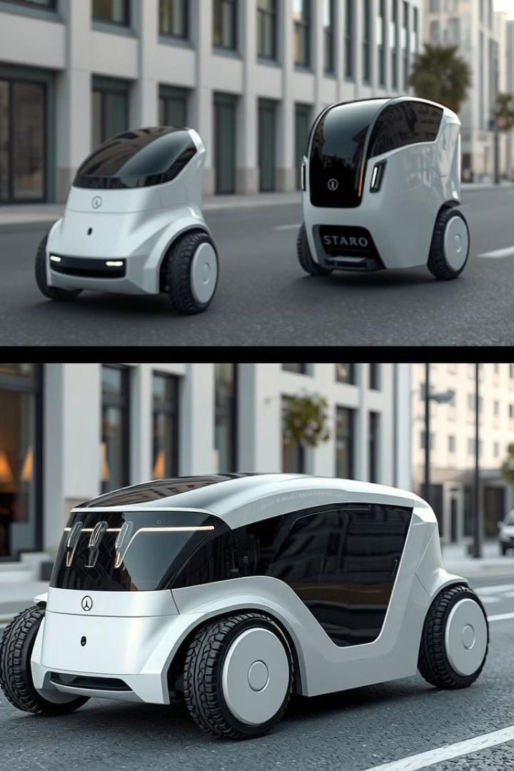
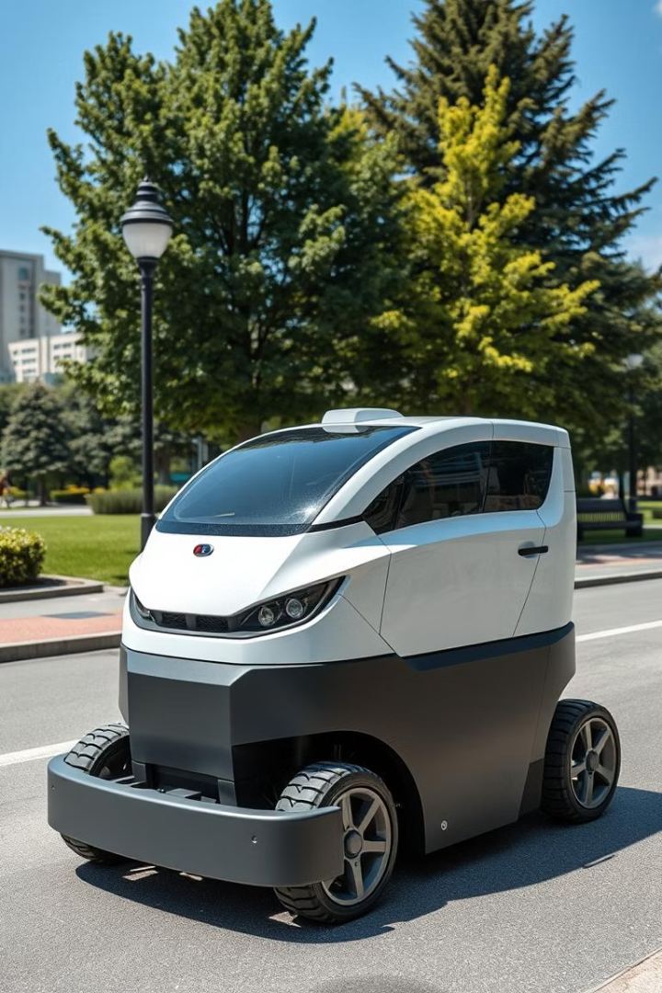
SOLAR BATTERY LEAF COLLECTOR ROBOMOBILE
Head: academician-scientist, designer, Laureate of the Nobel medal Burkit Aueskhan Kanoreuly
PhD, associate professor Kobeeva Zagira Saparbekovna
Purpose: to use the energy of solar batteries. Reducing the costs of using electricity. Equipment with automated, robotic, touch,camera sensors that do not harm the environment.
PROBLEM
TECHNICAL AND ECONOMIC INDICATORS
INTELLECTUAL PROPERTY PROTECTION
Production as a domestic product.
Sales market:
Solar battery robomobile with leaf collector necessary for the Kazakh country, regions, district, city/ village;"STARN-UP" - sensors and fast response:Effective work: optimize work by moving on programmed marchuruts.
Main resources:
Making a domestic mini shop ( plastic processing);Manufacture of robotic parts in domestic mini-workshops;A group of scientists and inventive students
Sales channels:
Online sales: Instagram, Tik -Tok, Telegram.
Marketplays (Kaspi, Wildberries, Ozon).
Offline sales: Eco-shops, robomobile (salons). University fairs and events. World-class “EXPO", Shymkent University-IT robotics and AI Kazakhstan, CIS countries and near and far abroad .
Solution
For the first time in the domestic market as a utility electric car and a robomobile to be withdrawn from the Mini-plant.
Main costs:
Raw materials: chips, cameras, solar battery, touch sensors, motors, laptop, mobile phone, 3D printer, plastic, etc – 1 10,000
PRODUCT
🔹 Leaves on the street as a domestic product of Kazakhstan. collect things, etc.
🔹 Экологиялық eco-friendly rabomobile, because it is energized by the sun's Rays.
🔹 Жетімді affordable price based on l
ocal production.
Team
Прогр programmers:
Тағаев Нұрлыбек Сейдуллаевич;
Жуманова Раушан Есенбековна;
Жолбарыс Ерғали Нұрлыбайұлы;
Джумагулов Нургали Султанкельдиевич;
Дулатов Самат Рахымбаевич.
COMPETITIVENESS
Competitors:
Imported domestic products.
Kazakhstan manufacturers ( inventor-constructor scientists).
The creators of the miniseries.
Advantages:
✅ Available at the expense of local production.
✅ Eco-product + support for sustainable consumption.
✅ Using artificial intelligence;
✅ Autonomous Work;
✅ Support for Student Startup universities, winning and implementing grants.
PAYBACK PERIOD
Initial capital :
JSC "Science Foundation" - JSC"National Agency for the development of innovations" QazinnovationsRepublican and International Committee for intellectual property protection ministry of Justice; Ministry of Science and higher education;IT robotics and artificial intelligence centers;Academy of invention and scientific pedagogical of Academician AUYESHAN.
Expected sales:
Solar battery robomobiles-5000$
sales per month - 1,000,000
pieces income per month-7000
$- annual income-84,000 $

